Slide 1

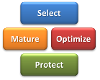
How to Right-Size Your Portfolio Management Implementation
By Tim Washington
Project World 2011
November 15-16th
Notes:
Title

Slide 2
Agenda
Overview of Portfolio Management
Portfolio Magnitude and Project Criticality
Accountability Framework
Examples
Q&R
Notes:
Thank you for coming. I am excited about this presentation. One note, the focus of the presentation is on right-sizing a portfolio management implementation, it is not as focused on HOW to implement PPM.
Q&R refers to questions and responses.

Slide 3
What is
“Project Portfolio Management”?
(and why does it matter?)
Notes:
Project Portfolio Management is not a simple topic. A wide variety of views exist on the topic and looking at various definitions helps supply a balanced and well-rounded view of the topic. It will also help you understand my views of PPM.

Slide 4
%Management Disciplines
Project portfolio management is a combination of various management disciplines:
Business management
General management
Project and program management
Notes:
According to IBM, PPM blends together three different aspects of management together and highlights the need of each component. Business management relates to understanding and managing strategies. General management is needed for successfully managing resources and risks. Finally, successful portfolio management requires managers who have some background in project management.
All three are important. For instance, how many of you have had to manage projects where the management sponsor was not familiar with project management processes? Management often wants to get things moving without the necessary planning, or may want certain data without understanding how to get that information.

Slide 5

PMI Quote
Project portfolio management (PPM) is a management discipline that drives strategic execution and maximizes organizational value through the selection, optimization, and oversight of project investments which align to business goals and strategies.
Notes:
Portfolio management helps to drive strategic execution. The path to execute strategy runs through PPM.
Value can have many meanings and needs to be defined by the organization implementing PPM. For some, value is strictly financial value. For others, value includes qualitative measures such as degree of strategic alignment. For others, value is totally qualitative without any quantitative measurements. We will come back to the matter of value shortly because it is important.
Paradigm Shift: projects are an important vehicle for executing strategy

Slide 6
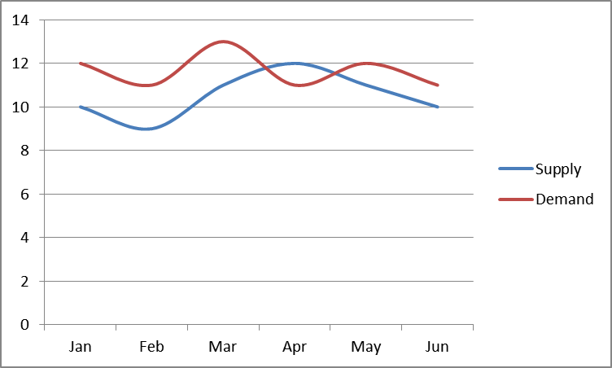
Stanford Quote
“Portfolio management is the strategy-based, prioritized set of all projects and programs in an organization reconciled to the resources available to accomplish them.”
Stanford Advanced Project Management
Notes:
Stanford’s quote is among the best and most concise. In addition to being strategy based, PPM also needs to reconcile the resources (human and financial) to accomplish project and program work. This is important, but not always easy to perform.
Paradigm Shift: Project Portfolio Management represents a shift of view from the single project view to a total portfolio view.

Slide 7

Financial Portfolio Quote
“Managing [the] composite groups of projects with the same rigor, balance, executive leadership, and decision-making involvement as the company’s financial portfolio. Portfolio Management is an ongoing process that includes decision-making, prioritization, review, realignment, and reprioritization.”
-Renee Sommer
Notes:
Finally, Project portfolio management can also be compared to a financial portfolio where the same rigor and discipline are needed to maximize value for the organization’s project portfolio.
We can adopt some of the principles for managing a financial portfolio. Certainly the idea of balancing investments comes in, balancing risk, long-term versus short-term, etc.
Paradigm Shift: Projects are investments!!

Slide 8

The Purpose of Portfolio Management
Execute Strategy
Maximize Organizational Value
Enhance Decision Making
Manage Organizational Change
Notes:
We touched on the first two items briefly.
PPM combined with good governance enables a management team to make better organizational decisions because the right data is in place. The mechanisms are in place to enhance decision making. Better processes + better data = better decisions. Another key is the timing of those decisions, a good leader will proactively collect/review the data to make good timely decisions.

Slide 9
PPM Goals
Portfolio Management Benefits:
Higher return on project investments
Lower organizational risk
Greater confidence of meeting customer commitments
Balanced project portfolio workload
Shorter project cycle times
Increased project throughput
Notes:
Based on the previous definitions, we can also articulate the benefits of project portfolio management. One of the top benefits is to maximize organizational value.

Slide 10
At the highest level, Project Portfolio Management has four basic components:
Select the Right
Projects
Selected projects must align with the business strategy and meet other important criteria.
Mature the
Portfolio Processes
Optimize the
Portfolio
The Goal:
Maximize Value to the Organization
Higher portfolio maturity translates into a greater realization of the benefits of project portfolio management.
All the steps necessary to construct an optimal portfolio given current limitations and constraints.
Protect the
Portfolio’s Value
Project benefits must be protected in order to deliver maximum portfolio value.
Notes:
The project portfolio lifecycle is very important and provides a conceptual overview of PPM. Portfolio management enables strategic execution, and projects help accomplish strategic goals.
Therefore, the first step is to select the right projects. Without the right projects, an organization cannot accomplish its strategic goals.
The second step is to optimize the project portfolio. This includes prioritization and resource capacity management.
The third step is to protect the portfolio’s value. The project portfolio has inherent value and the key is to ensure that each project delivers the value it intended from the beginning.
The final step is to mature the portfolio’s processes. Higher maturity translates into greater benefits of the process. Validating project benefits and using this information is a key step for maturing the portfolio processes.
Again, the goal is to maximize value to the organization.

Slide 11
A good governance structure is central to making PPM work.
PORTFOLIO GOVERNANCE
(Strategic Direction)
Select the Right
Projects
“Portfolio management without governance is an empty concept.”
Mature the
Portfolio Processes
Optimize the
Portfolio
Protect the
Portfolio’s Value
Notes:
This slide highlights that the PPM processes operate within a good governance framework (structure). Without solid governance processes, portfolio management is an empty concept.

Slide 12
Agenda
Overview of Portfolio Management
Project Criticality and Portfolio Magnitude
Accountability Framework
Examples
Q&R
Notes:
Now we’d like to take a turn and focus on the concepts of project criticality and portfolio magnitude

Slide 13
Project Criticality: Project importance
(Examples: degree of increasing revenue, importance of strategic execution, risk of failure, risk of not doing the project, financial ramifications, critical dependencies.)
Portfolio Magnitude: Portfolio breadth
(Examples: factors such as budget, total human resources, breadth of organization/portfolio [local, regional, national, international, business units]).
Notes:
Magnitude: includes factors such as budget, total human resources, breadth of organization/portfolio (local, regional, national, international, business units)
Criticality: degree of increasing revenue, importance of strategic execution, ability to manage organizational change, risk of failure, risk of not doing the project, financial ramifications, critical dependencies (downstream ripple effect of not accomplishing)

Slide 14


How Much Value Do You Need To Deliver?
This will drive the scope of your implementation
Notes:
Project value directly relates to project criticality

Slide 15
Large Portfolio
Level 5
Portfolio Magnitude
Manual PPM Process/Tool
Level 1
Level 2
Level 3
Level 4
Very Critical Projects
Project Criticality
Notes:
Identifying the end state (also known as ‘future state’) portfolio processes has rarely been discussed in portfolio management literature. More common are discussions about project portfolio maturity. The common thought has been to endeavor to reach the highest level of maturity possible. Until now, there has been little acknowledgement that some organizations may not need to strive for level 5 (“optimized”) maturity (an elusive state of maturity to say the least). However, organizations can make a general determination of where their portfolio processes need to be in order to have a legitimate competitive advantage. Having this understanding gives the organization a realistic target for improvement. Such a determination can be made based on two important factors: project criticality (the importance of projects to the organization) and portfolio size (probably in dollars, but for the time being will not be quantified). In order to make a realistic assessment of future state portfolio processes, the portfolio management team first needs to make an honest assessment of project criticality (not an easy task).

Slide 16
What is Driving Your PPM Implementation?
Improve Demand Management?
Project Selection
Improve Strategic Alignment?
Prioritization
Capacity Management
Project Sequencing
Improve Project Execution?
Improve Decision Making?
Efficient Governance
Balance Investments?
Portfolio Balancing
Maximize Organizational Value?
Portfolio Optimization

Slide 17
PPM Components | Level 1 | Level 2 | Level 3 | Level 4 | Level 5
Project Selection
Prioritization
Portfolio Balancing
Efficient Governance
Capacity Management
Portfolio Optimization
Implementation objectives will help determine maturity targets
Notes:
These are some of the key components of portfolio management.

Slide 18

At What Caliber Does Your Organization Need to Perform?
Level 1—Ad hoc, “Street Ball”
Level 2—Developing, “High School Level”
Level 3—Defined, “Collegiate Level”
Level 4—Managed, “Professional Level”
Level 5—Optimized, “Championship Level”
Notes:
We can connect the previous slide to this slide. The people in your organization to perform at a certain level and have a certain ability to carry out project and portfolio management disciplines. This touches the senior management team and project managers directly.

Slide 19
Agenda
Overview of Portfolio Management
Portfolio Magnitude and Project Criticality
Accountability Framework
Examples
Q&R

Slide 20
Critical Components of Accountability
Leadership
to Drive
Accountability
Governance as
the Framework
Which Enables
Accountability
A Shared Vision
With Strategic Goals
to Demonstrate
Accountability

Slide 21


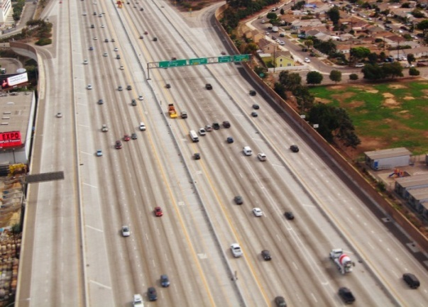

What Kind of Governance Do You Need?
PPM is only bureaucratic if you have the wrong infrastructure
Notes:
Tokyo example

Slide 22


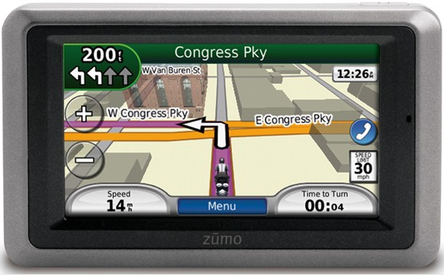
What Kind of Direction Do You Need?
“Informed Intuition”
Strategic Goals
Strategic Roadmap with Metrics
Notes:
You can have a compass without a map. What would you rather have?
What mountain are you going to climb?

Slide 23

What Quality of Leadership Do You Have?
Disengaged
Short-sighted
Weak Communicator
Very Engaged
Proactive
Strong Communicator
Leadership Quality Will Drive PPM Quality

Slide 24
Strategic leadership requires:
Active engagement
Being proactive
Balancing long-term and short-term needs
Communicating a consistent message

Slide 25
Critical Components of Accountability
Leadership
to Drive
Accountability
Governance as
the Framework
Which Enables
Accountability
A Shared Vision
With Strategic Goals
to Demonstrate
Accountability

Slide 26
Agenda
Overview of Portfolio Management
Portfolio Magnitude and Project Criticality
Accountability Framework
Examples
Q&R

Slide 27



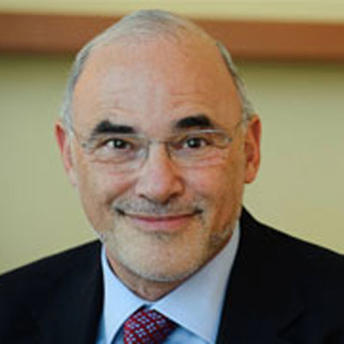
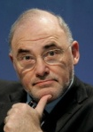

Example #1 Hewlett-Packard
Fortune 500 Rank: #10
$114.5 Billion revenue, $7.66 Billion in profit in 2010
4/3/2010
4/28/2010
9/30/2010
HP Bought Palm for $1.2 Billion
“Palm’s innovative operating system provides an ideal platform to expand HP’s mobility strategy…”
“Advances in mobility are offering significant opportunities, and HP intends to be a leader in this market.”
Léo Apotheker Named CEO and President of HP
"Léo is a strategic thinker with a passion for technology, wide-reaching global experience and proven operational discipline - exactly what we were looking for in a CEO."
Léo Apotheker Fired
"We are at a critical moment and we need renewed leadership to successfully implement our strategy…”
“The problem with Apotheker wasn't lack of vision as much as a lack of execution and communication”
8/18/2011
9/22/2011
Notes:
http://techcrunch.com/2011/11/21/hps-failed-webos-experiment-cost-them-3-3-billion-but-whats-next/

Slide 28

Example #2 City of Bellevue
Ranked 4th Best City of Live In (2010)
Population: 124,000
$1 Billion Bi-annual budget
Local initiatives cut tax revenue down to 1% annually
The Bellevue city council proactively made plans to address the recession by developing a new budgeting process called “Budget One”
Open and frank communication—“Our traditional way of developing a budget—department by department—must make way for a process that targets spending with specific community needs”
Budget One was a ‘fundamental reset’: Instead of asking the traditional question of “what are we going to cut?”, the new question was “what are we buying?”

Slide 29
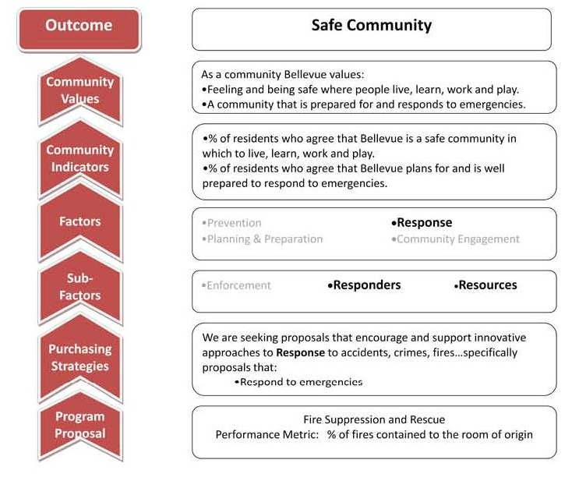

Slide 30
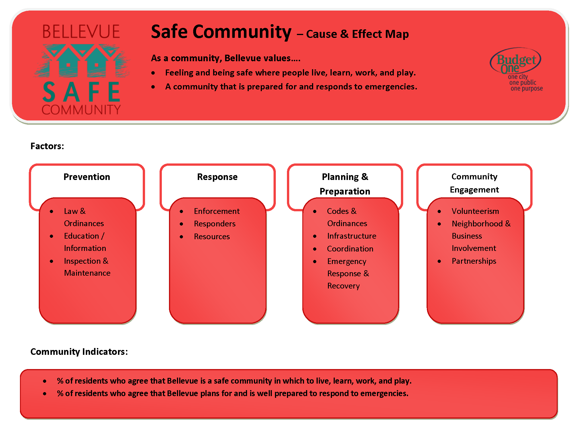

Slide 31
Summary
Consider project criticality and portfolio magnitude
Understand what the ‘end state’ of your portfolio process should be based on organizational needs
Understand the level of caliber needed to be successful
Enable accountability with solid governance
Demonstrate accountability with well thought-out goals and roadmaps
Drive accountability with good leadership

Slide 32
Questions?

Slide 33
Thank You for listening and for providing feedback

Slide 34


Contact Information
Name: Tim Washington
Email: twashin@costco.com
Web: www.ppmexecution.com
@ppmexecution
http://www.linkedin.com/in/timawashington

Slide 35
Resources
Balducci, Claudia. Personal interview on February 7th, 2011.
“Budget One Requests for Results”, Bellevuewa.gov. April 6th, 2010. http://www.bellevuewa.gov/budgets.htm
Ciliberti, Rachel. “Using Project Portfolio Management to Improve Business Value.” DevX.com. March 26, 2007. <http://www.devx.com/ibm/Article/27984>.
Datz, Todd. “Portfolio Management: How to Do It Right.” CIO.com. Ed. Todd Datz. May 1, 2003. March 26, 2007. http://www.cio.com/archive/050103/portfolio.html
Fortune 500 Ranking http://money.cnn.com/magazines/fortune/fortune500/2010/full_list/
Goldman, David, “HP CEO Apotheker fired, replaced by Meg Whitman”, September 22, 2011, <http://money.cnn.com/2011/09/22/technology/hp_ceo_fired/index.htm>
HP News Release, “HP to Acquire Palm for $1.2 Billion”, <http://www.hp.com/hpinfo/newsroom/press/2010/100428xa.html>
HP Financial News, Léo Apotheker Named CEO and President of HP, <http://h30261.www3.hp.com/phoenix.zhtml?c=71087&p=irol-newsArticle&ID=1477863&highlight=>
Morgan, Mark, Raymond E. Levitt, William Malek Executing Your Strategy: How to Break It Down and Get It Done. Boston, MA: Harvard Business School Press, 2007
Robertson, Jennifer. Personal interview on January 28th, 2011.
Sommer, Renee. “Portfolio Management for Projects: A New Paradigm,” in Project Portfolio Management, Lowell D. Dye and James S. Pennypacker, (eds.), West Chester, PA: Center for Business Practices, 1999, pp. 55-60.

